Slide 1


Pankaj Sonawane
07-Jul-2024

Slide 2

Outline
Executive Summary
Introduction
Methodology
Insights drawn from EDA
Launch Sites – Proximity Analysis
Building a Dashboard with Plotly Dash
Predictive Analysis (Classification)

Slide 3
Executive Summary
Summary of methodologies
Data Collection through API
Data Collection with Web Scraping
Data Wrangling
Exploratory Data Analysis with SQL
Exploratory Data Analysis with Data Visualization
Interactive Visual Analytics with Folium
Machine Learning Prediction
Summary of all results
Exploratory Data Analysis
Interactive Analytics in Screenshots
Predictive Analytics
This project leverages data science techniques to address a critical aspect of space exploration economics. By predicting the success of Falcon 9 rocket landings, we aim to provide actionable insights that can drive competitive strategies and enhance the cost-efficiency of space launches.

Slide 4
Introduction
Project background and context
SpaceX advertises Falcon 9 rocket launches for $62 million each on its website.
Other providers charge around $165 million for each launch. SpaceX saves money because it can reuse the first stage of the rocket.
If we know whether the first stage will land successfully, we can figure out the cost of a launch. This information can help another company compete with SpaceX for a rocket launch contract.
The goal of this project is to create a machine learning system to predict if the first stage will land successfully.
Problems you want to find answers
Identifying all factors that influence the landing outcome.
The relationship between each variables and how it is affecting the outcome.
The best condition needed to increase the probability of successful landing.

Slide 5

Section 1

Slide 6
Methodology
Methodology
Data collection methodology:
Data was collected using SpaceX API and web scraping from Wikipedia.
Perform data wrangling
One-hot encoding was applied to categorical features
Perform exploratory data analysis (EDA) using visualization and SQL
Perform interactive visual analytics using Folium and Plotly Dash
Perform predictive analysis using classification models
How to build, tune, evaluate classification models

Slide 7
Data Collection
The data was collected using various methods
Data collection was done using get request to the SpaceX API.
Next, we decoded the response content as a Json using .json() function call and turn it into a pandas dataframe using .json_normalize().
We then cleaned the data, checked for missing values and fill in missing values where necessary.
In addition, we performed web scraping from Wikipedia for Falcon 9 launch records with BeautifulSoup.
The objective was to extract the launch records as HTML table, parse the table and convert it to a pandas dataframe for future analysis.

Slide 8
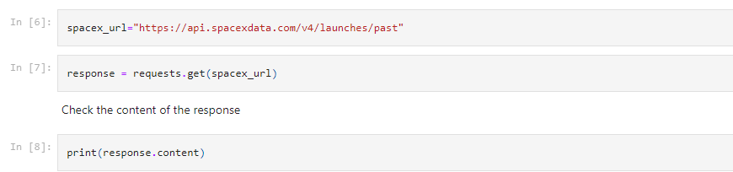
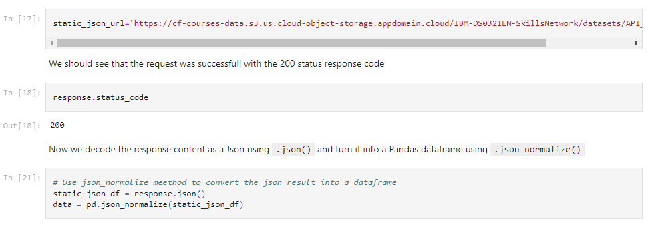
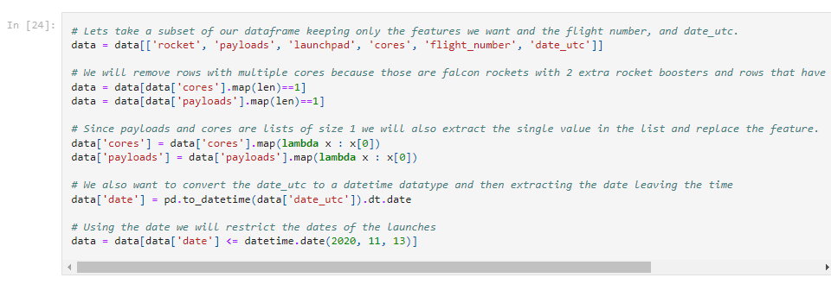
Data Collection – SpaceX API
Get request for rocket launch
data using API
Use json_normalize method to
convert json result to dataframe
Performed data cleaning and
filling the missing value
GitHub URL of the completed SpaceX API calls
https://github.com/pankajsonawane2711/DS-CapstoneProject-SpaceX/blob/main/jupyter-labs-spacex-data-collection-api.ipynb

Slide 9
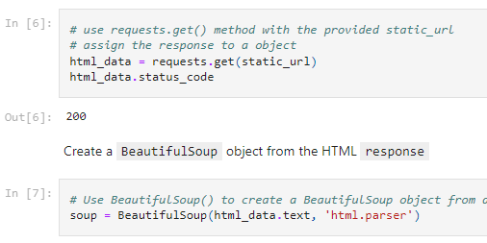
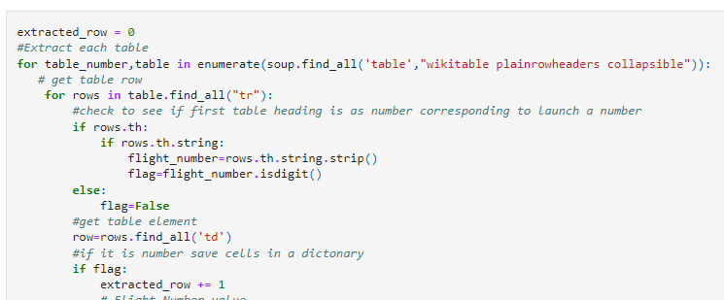
Data Collection - Scraping
Request the Falcon9
Launch Wiki page from url
Create a BeautifulSoup from the HTML response
Extract all column/variable names from the HTML header
GitHub URL for the process
https://github.com/pankajsonawane2711/DS-CapstoneProject-SpaceX/blob/main/jupyter-labs-webscraping.ipynb

Slide 10

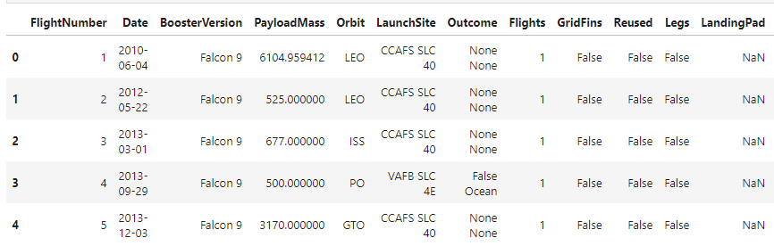
Data Wrangling
We performed exploratory data analysis and determined the training labels.
We calculated the number of launches at each site, and the number and occurrence of each orbits
We created landing outcome label from outcome column and exported the results to csv.
GitHub URL for Data Wrangling
https://github.com/pankajsonawane2711/DS-CapstoneProject-SpaceX/blob/main/labs-jupyter-spacex-Data%20wrangling.ipynb

Slide 11
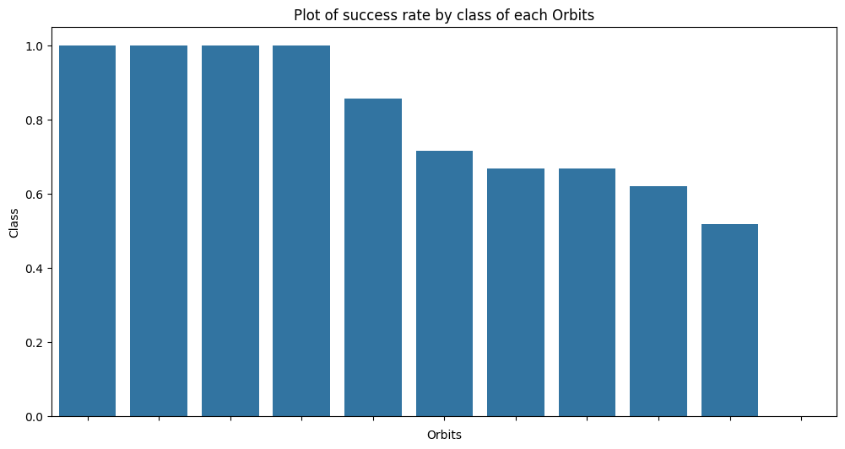
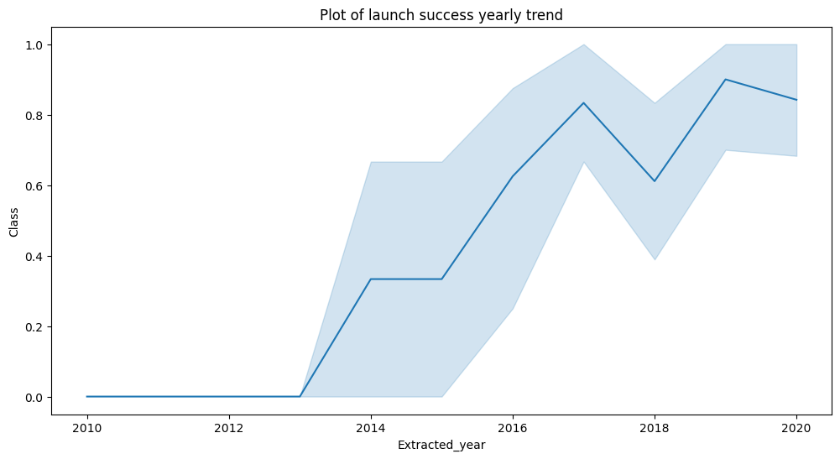
EDA with Data Visualization
Once we get a hint of the relationships using scatter plot. We will then use further visualization tools such as bar graph and line plots graph for further analysis.
Bar graphs is one of the easiest way to interpret the relationship between the attributes. In this case, we will use the bar graph to determine which orbits have the highest probability of success.
We then use the line graph to show a trends or pattern of the attribute over time which in this case, is used for see the launch success yearly trend.
We then use Feature Engineering to be used in success prediction in the future module by created the dummy variables to categorical columns.
ES-11. GE-0 HEO, SSO have high success rates
you can observe that the sucess rate since 2013 kept increasing till 2020
GitHub URL for EDA with Data Visualization
https://github.com/pankajsonawane2711/DS-CapstoneProject-SpaceX/blob/main/edadataviz.ipynb

Slide 12
EDA with SQL
Using SQL, we had performed many queries to get better understanding of the dataset, Ex:
Displaying the names of the launch sites.
Displaying 5 records where launch sites begin with the string ‘CCA’.
Displaying the total payload mass carried by booster launched by NASA (CRS).
Displaying the average payload mass carried by booster version F9 v1.1.
Listing the date when the first successful landing outcome in ground pad was achieved.
Listing the names of the boosters which have success in drone ship and have payload mass greater than 4000 but less than 6000.
Listing the total number of successful and failure mission outcomes.
Listing the names of the booster_versions which have carried the maximum payload mass.
Listing the failed landing_outcomes in drone ship, their booster versions, and launch sites names for in year 2015.
Rank the count of landing outcomes or success between the date 2010-06-04 and 2017-03-20, in descending order.
We loaded the SpaceX dataset into SQL database without leaving the Jupyter notebook
GitHub URL for EDA with SQL
https://github.com/pankajsonawane2711/DS-CapstoneProject-SpaceX/blob/main/jupyter-labs-eda-sql-coursera_sqllite.ipynb

Slide 13
Build an Interactive Map with Folium
To visualize the launch data into an interactive map. We took the latitude and longitude coordinates at each launch site and added a circle marker around each launch site with a label of the name of the launch site.
We then assigned the dataframe launch_outcomes(failure,success) to classes 0 and 1 with Red and Green markers on the map in MarkerCluster().
We then used the Haversine’s formula to calculated the distance of the launch sites to various landmark to find answer to the questions of:
How close the launch sites with railways, highways and coastlines?
How close the launch sites with nearby cities?
GitHub URL for Map with Folium
https://github.com/pankajsonawane2711/DS-CapstoneProject-SpaceX/blob/main/lab_jupyter_launch_site_location.ipynb

Slide 14
Build a Dashboard with Plotly Dash
We built an interactive dashboard with Plotly dash which allowing the user to play around with the data as they need.
We plotted pie charts showing the total launches by a certain sites.
We then plotted scatter graph showing the relationship with Outcome and Payload Mass (Kg) for the different booster version.
GitHub URL for Dashboard with Plotly Dash
https://github.com/pankajsonawane2711/DS-CapstoneProject-SpaceX/blob/main/spacex_dash_app.py

Slide 15
Predictive Analysis (Classification)
Building the Model
Evaluating the Model
Improving the Model
Find the Best Model
Load the dataset into NumPy and Pandas
Transform the data and then split into training and test datasets
Decide which type of ML to use
Set the parameters and algorithms to GridSearchCV and fit it to dataset.
Check the accuracy for each model
Get tuned hyperparameters for each type of algorithms.
Plot the confusion matrix.
Use Feature Engineering and Algorithm Tuning
The model with the best accuracy score will be the best performing model.
GitHub URL for Predictive Analysis
https://github.com/pankajsonawane2711/DS-CapstoneProject-SpaceX/blob/main/SpaceX_Machine%20Learning%20Prediction_Part_5.ipynb

Slide 16
Results
The results will be categorized to 3 main results which is:
01
Exploratory data analysis results
02
Interactive analytics demo in screenshots
03
Predictive analysis results

Slide 17

Section 2

Slide 18
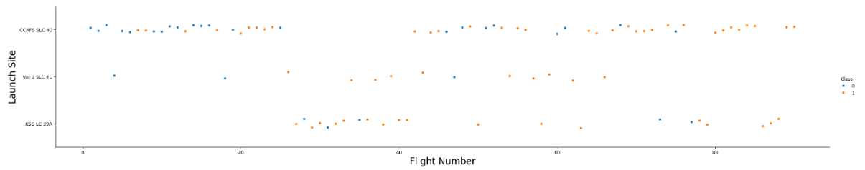
Flight Number vs. Launch Site
This scatter plot shows that the larger the flights amount of the launch site, the greater the the success rate will be.
However, site CCAFS SLC40 shows the least pattern of this.

Slide 19
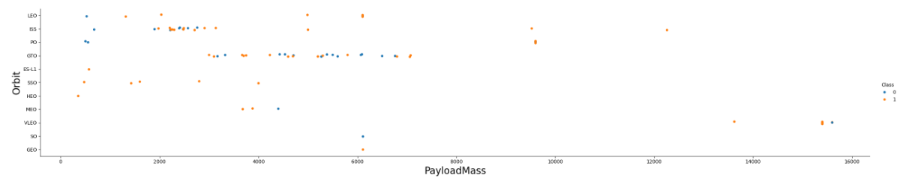
Payload vs. Launch Site
With heavy payloads the successful landing or positive landing rate are more for Polar,LEO and ISS.
This scatter plot shows once the pay load mass is greater than 7000kg, the probability of the success rate will be highly increased.
However, there is no clear pattern to say the launch site is dependent to the pay load mass for the success rate.

Slide 20

Success Rate vs. Orbit Type
From the plot, we can see that ES-L1, GEO, HEO, SSO, VLEO had the most success rate.

Slide 21
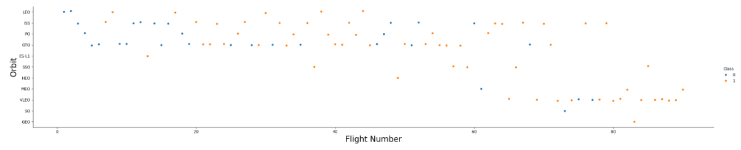
Flight Number vs. Orbit Type
The plot below shows the Flight Number vs. Orbit type. We observe that in the LEO orbit, success is related to the number of flights whereas in the GTO orbit, there is no relationship between flight number and the orbit.

Slide 22
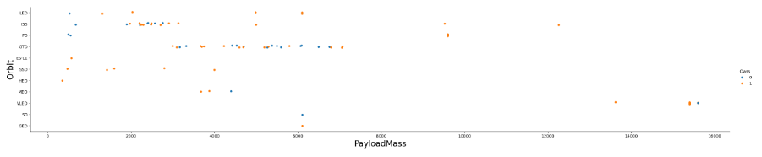
Payload vs. Orbit Type
We can observe that with heavy payloads, the successful landing are more for PO, LEO and ISS orbits.

Slide 23
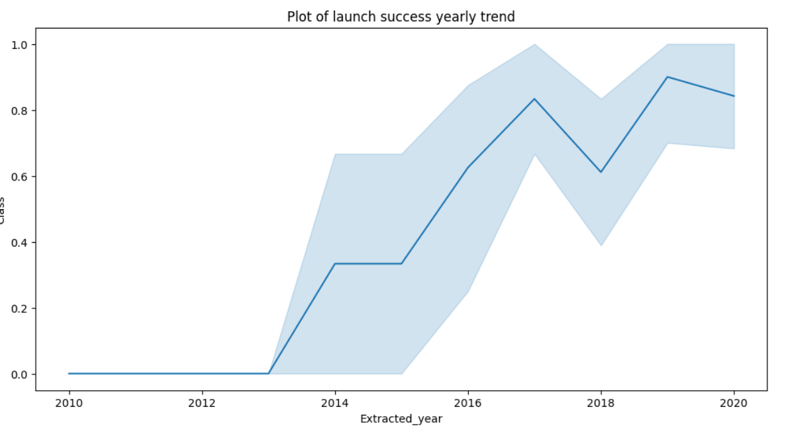
Launch Success Yearly Trend
From the plot, we can observe that success rate since 2013 kept on increasing till 2020.

Slide 24
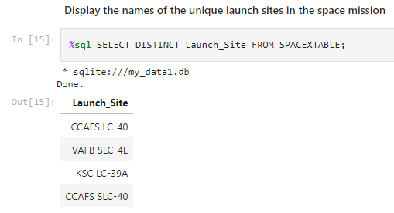
All Launch Site Names
We used the key word DISTINCT to show only unique launch sites from the SpaceX data.

Slide 25
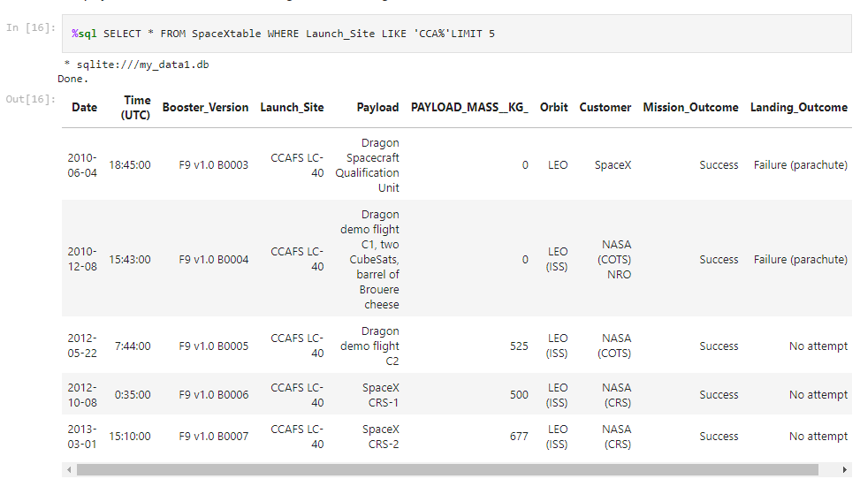
Launch Site Names Begin with 'CCA'
We used the query above to display 5 records where launch sites begin with `CCA`

Slide 26
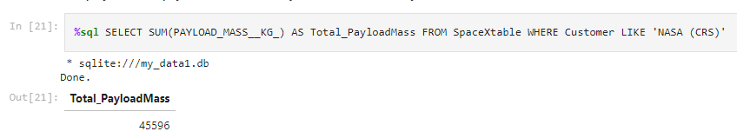
Total Payload Mass
We calculated the total payload carried by boosters from NASA as 45,596 using the query below

Slide 27
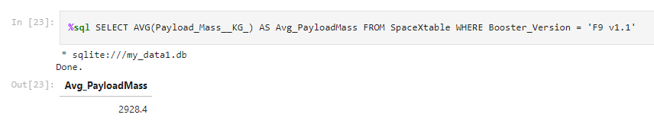
Average Payload Mass by F9 v1.1
We calculated the average payload mass carried by booster version F9 v1.1 as 29,28.4

Slide 28
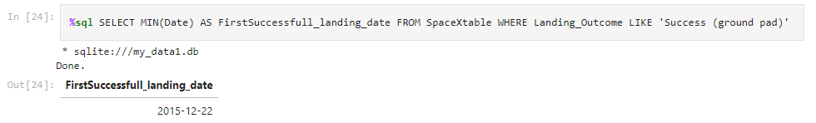
First Successful Ground Landing Date
We observed that the dates of the first successful landing outcome on ground pad was
22nd December 2015

Slide 29
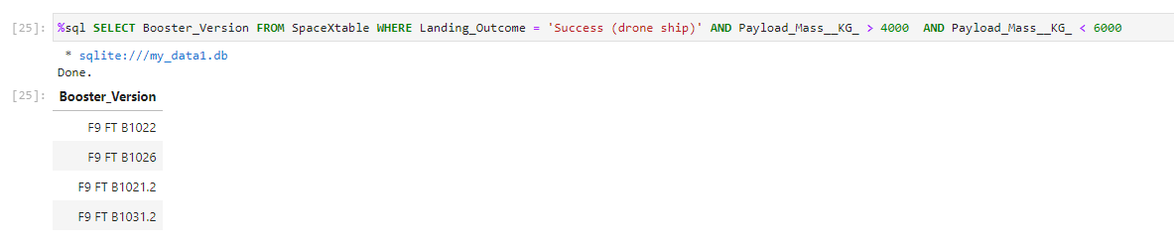
Successful Drone Ship Landing with Payload between 4000 and 6000
We used the WHERE clause to filter for boosters which have successfully landed on drone ship and applied the AND condition to determine successful landing with payload mass greater than 4000 but less than 6000

Slide 30
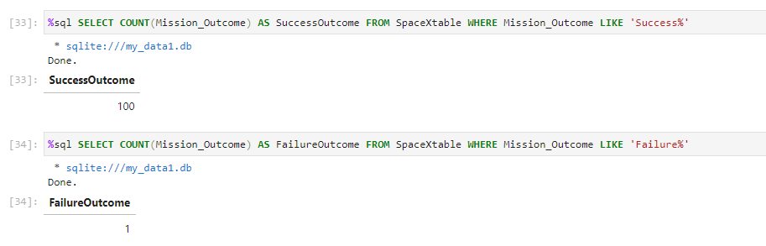
Total Number of Successful and Failure Mission Outcomes
We used wildcard like ‘%’ to filter for WHERE Mission Outcome was a success or a failure.

Slide 31
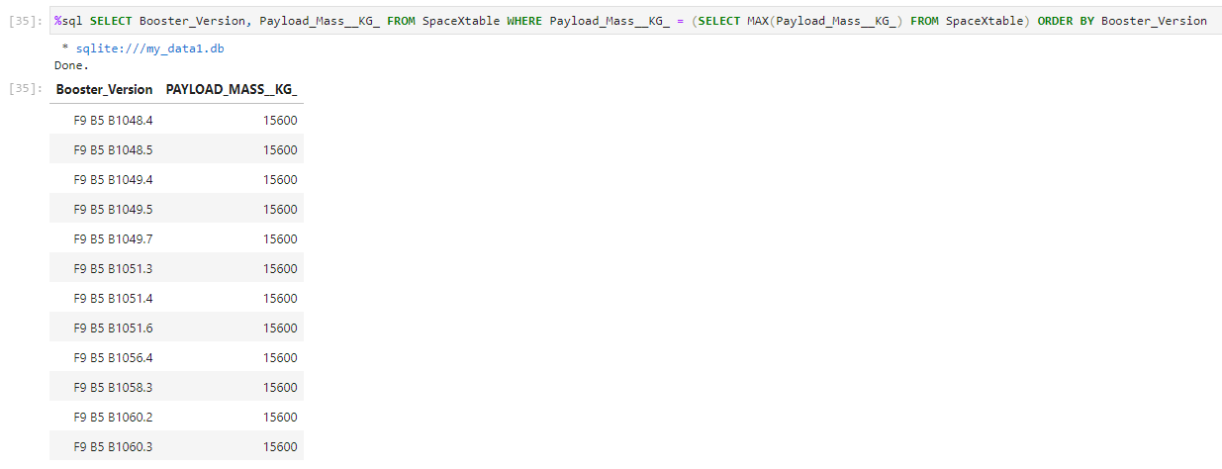
Boosters Carried Maximum Payload
We determined the booster that have carried the maximum payload using a subquery in the WHERE clause and the MAX() function.

Slide 32
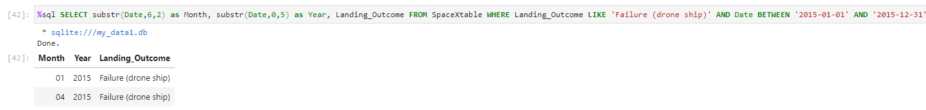
2015 Launch Records
We used a combinations of the WHERE clause, LIKE, AND, and BETWEEN conditions to filter for failed landing outcomes in drone ship, their booster versions, and launch site names for year 2015

Slide 33
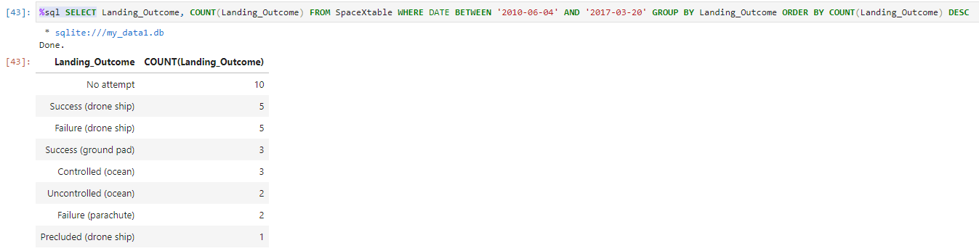
Rank Landing Outcomes Between 2010-06-04 and 2017-03-20
We selected Landing outcomes and the COUNT of landing outcomes from the data and used the WHERE clause to filter for landing outcomes BETWEEN 2010-06-04 to 2010-03-20.
We applied the GROUP BY clause to group the landing outcomes and the ORDER BY clause to order the grouped landing outcome in descending order.

Slide 34

Section 3

Slide 35
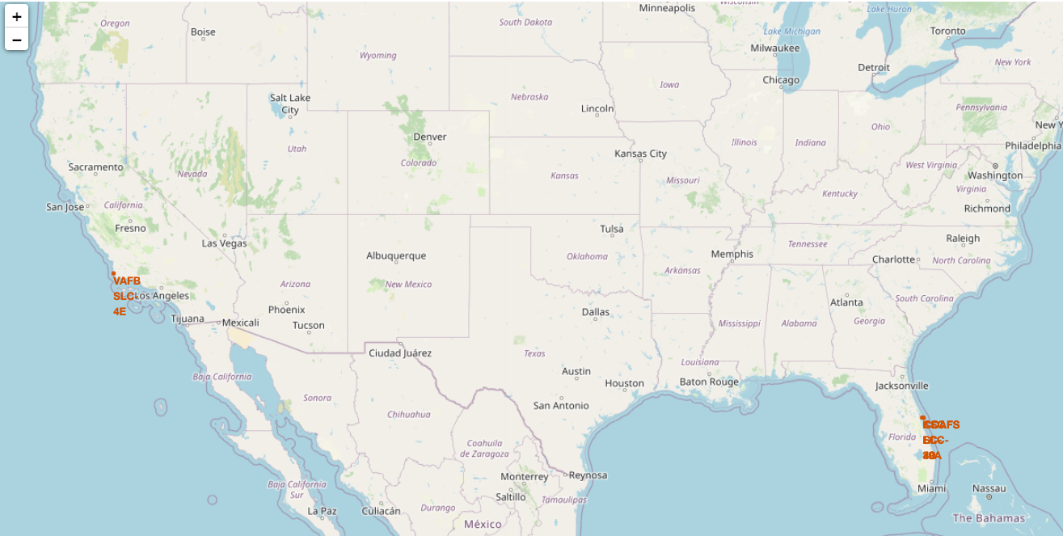
All launch sites global map markers
We can see that all the SpaceX launch sites are located inside the United States

Slide 36
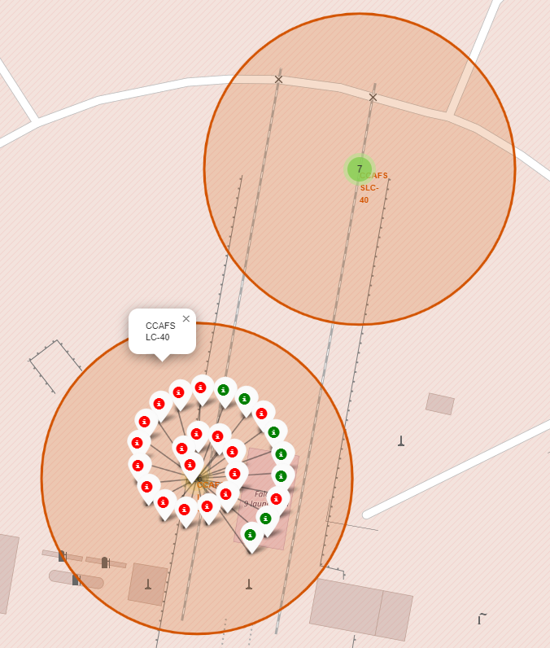
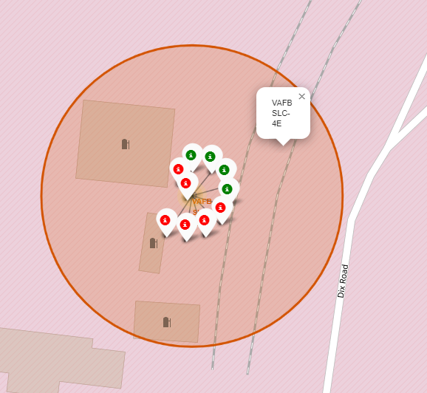
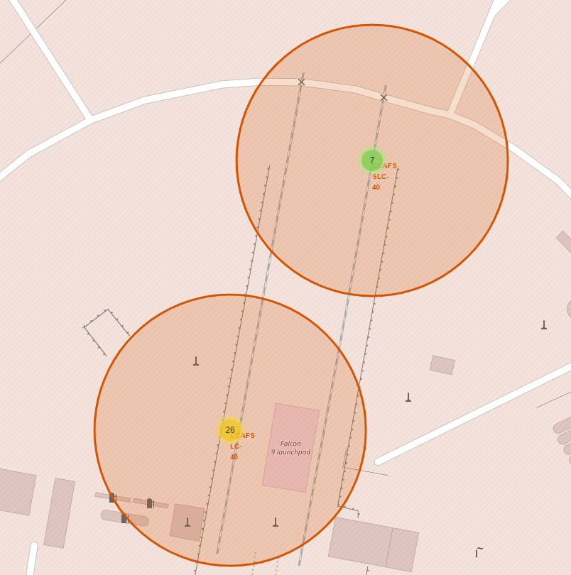
Markers showing launch sites with color labels
Florida Launch site
California Launch site
Green Markers show successful launches & Red Markers show Failures

Slide 37
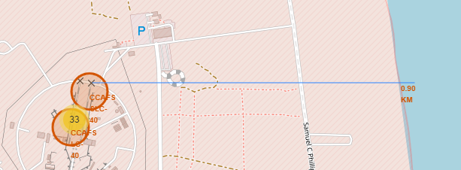
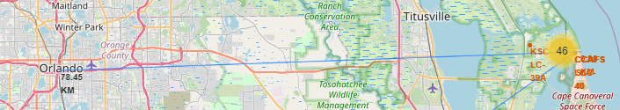
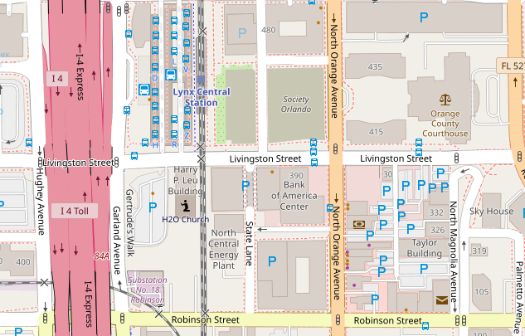
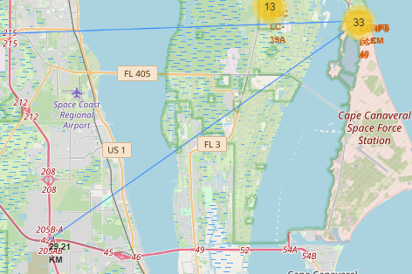
Launch Sites Distance to Landmarks
Distance to Coast
Distance to Closest City
Distance to Closest Highway
Distance to Closest Railway Station
Are launch sites in close proximity to railways? No
Are launch sites in close proximity to highways? No
Are launch sites in close proximity to coastline? Yes
Do launch sites keep certain distance away from cities? Yes

Slide 38

Section 4

Slide 39

The success percentage by each sites
Total Success Launches by All sites
We can see that KSC LC-39A had the most successful launches from all the sites

Slide 40

The highest launch-success ratio: KSC LC-39A
Highest launch-success ratio
KSC LC-39A achieved a 76.9% success rate while getting a 23.1% failure rate

Slide 41

Payload vs Launch Outcome Scatter Plot
Low Weighted Payload 0kg – 4000kg
Heavy Weighted Payload 4000kg – 1000kg
We can see that all the success rate for low weighted payload is higher than heavy weighted payload

Slide 42

Section 5

Slide 43
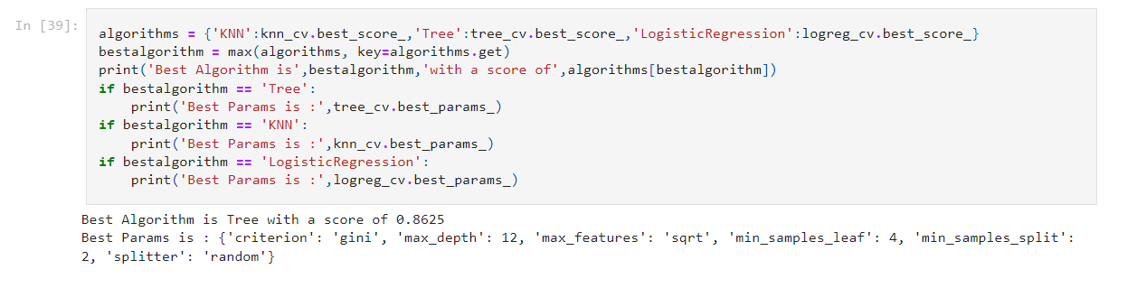
Classification Accuracy
As we can see, by using the code as above: we could identify that the best algorithm to be the Tree Algorithm which have the highest classification accuracy.

Slide 44

Confusion Matrix
The confusion matrix for the decision tree classifier shows that the classifier can distinguish between the different classes. The major problem is the false positives .i.e., unsuccessful landing marked as successful landing by the classifier.

Slide 45
Conclusions
Starting from the year 2013, the success rate for SpaceX launches is increased, directly proportional time in years to 2020, which it will eventually perfect the launches in the future.
KSC LC-39A have the most successful launches of any sites; 76.9%
Orbits ES-L1, GEO, HEO, SSO, VLEO had the most success rate
SSO orbit have the most success rate; 100% and more than 1 occurrence.
The low weighted payloads (which define as 4000kg and below) performed better than the heavy weighted payloads.
The Tree Classifier Algorithm is the best Machine Learning approach for this dataset.

Slide 46
Appendix
Code and Datasets to download
https://github.com/pankajsonawane2711/DS-CapstoneProject-SpaceX/blob/main/dataset_part_1.csv
https://github.com/pankajsonawane2711/DS-CapstoneProject-SpaceX/blob/main/dataset_part_2.csv
https://github.com/pankajsonawane2711/DS-CapstoneProject-SpaceX/blob/main/dataset_part_3.csv
https://github.com/pankajsonawane2711/DS-CapstoneProject-SpaceX/blob/main/my_data1.db
https://github.com/pankajsonawane2711/DS-CapstoneProject-SpaceX/blob/main/spacex_dash_app.py
https://github.com/pankajsonawane2711/DS-CapstoneProject-SpaceX/blob/main/spacex_launch_dash.csv

Slide 47


